Slide 1

Teleoperation of a robotic arm made with Lego Mindstorm using an accelerometer sensor HiTechnic
Teleoperation and Telepresence in Robotic
Master in Robotics and Automation
Carlos III University of Madrid
Pérula Martínez, Raúl
(raul.perula@alumnos.uc3m.es)

Slide 2
Index
Teleoperation system elements
Teleoperation architecture
Control mode
Software system
Conclusions and Futures improvements

Slide 3
Teleoperation system elements
Mainly elements in a teleoperated system are:
Operator
Teleoperated device
Sensors
Interface
Control and communication channels

Slide 4
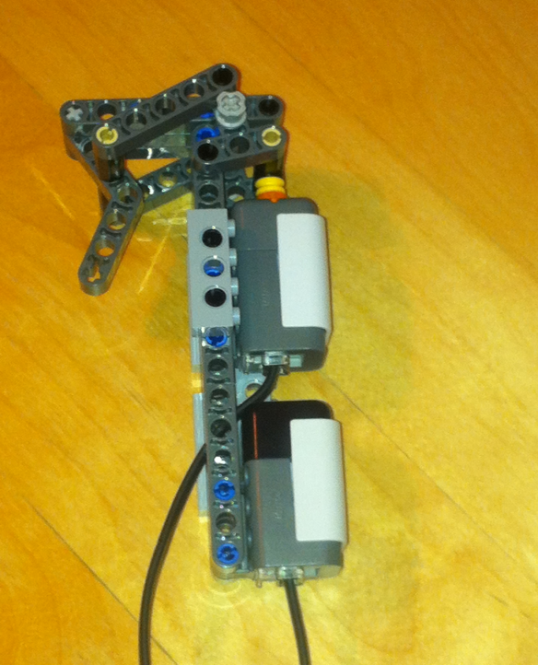
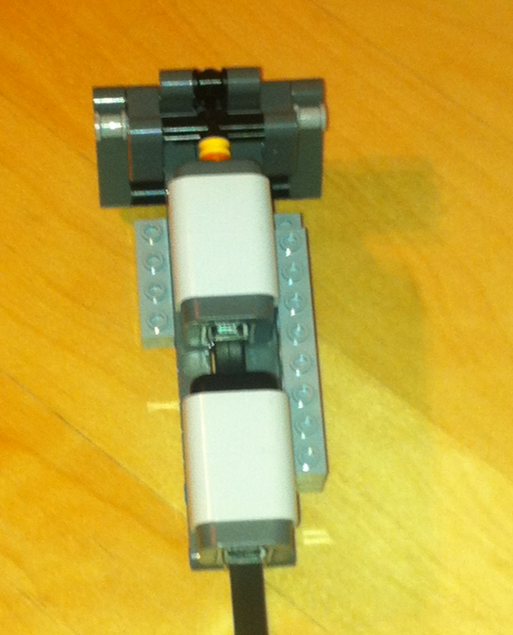
Teleoperation system elements
Operator
People who manage and control the robot remotely.
He will handle by hand controller (joystick) which shall consist of the sensor that will move the device.

Slide 5
Teleoperation system elements
Teleoperated device
It’s the device in the remote area which is constrolled by the operator.
Consist of a mechanism in which the movement will be equal to that made by the operator.
Has two degrees of freedom to move around the three coordinate axes (3D).
At the end of the arm have a gripper to manipulate objects.

Slide 6
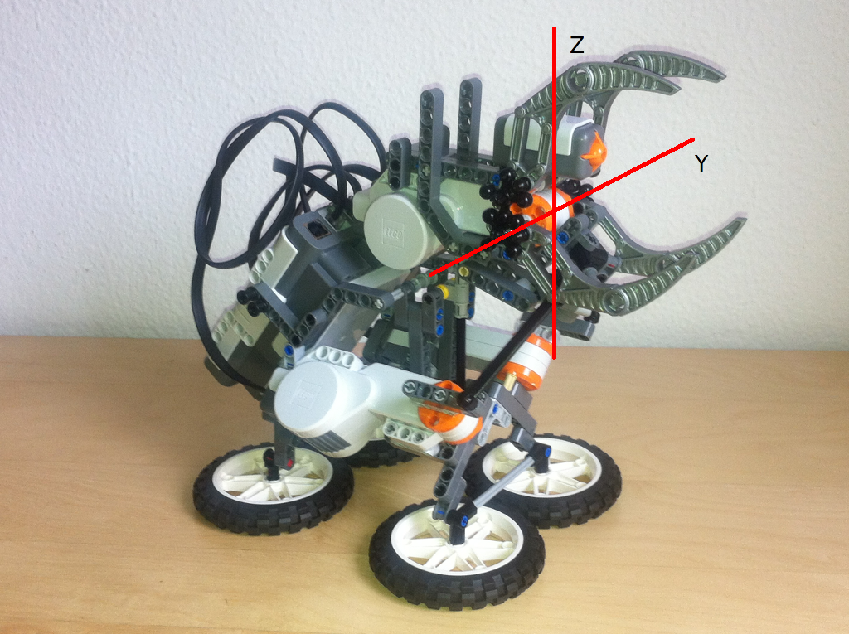
Teleoperation system elements
Teleoperated device

Slide 7
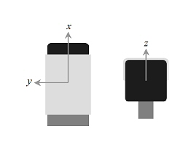
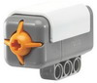
Teleoperation system elements
Sensors
Acceleration sensor
Touch sensor

Slide 8
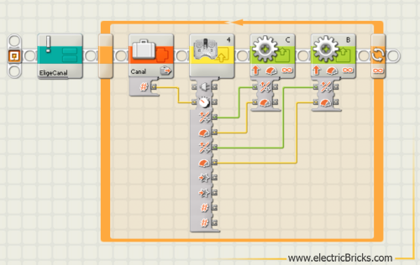
Teleoperation system elements
Interface
The interface to control the robotic device is provided by Lego Mindstorm.
Based on block-structured programming.

Slide 9
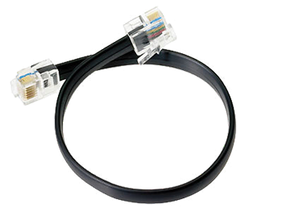
Teleoperation system elements
Control and communication channels
Communication channels are made using a data transmission cable standard NXT working via I2C digital communications protocol.

Slide 10
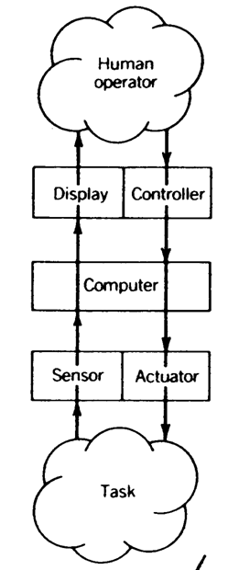
Teleoperation architecture
The architecture followed to implement the project has been a control supervised architecture.

Slide 11
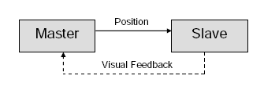
Control mode
Uses a master-slave control methodology, the slave robot exactly replicates the movements of the master.
In a unilateral control system, no force feedback is available from the slave unit.
The only form of feedback to the master unit operator is in the form of vision data.

Slide 12
Software system
Two distinct parts.
The first is responsible for performing control for the arm to move in the same way in which the operator moves the handle.

Slide 13
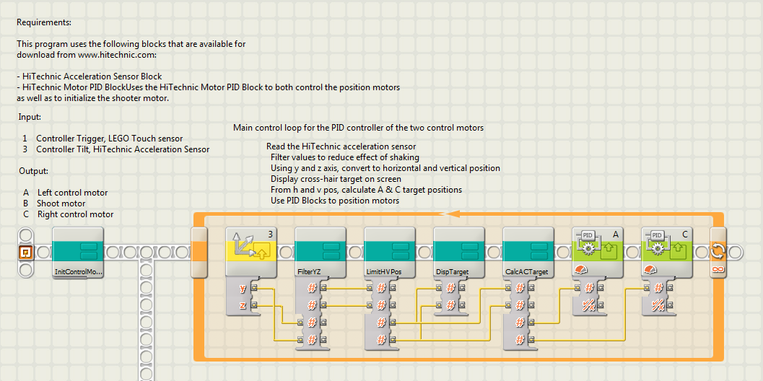
Software system

Slide 14
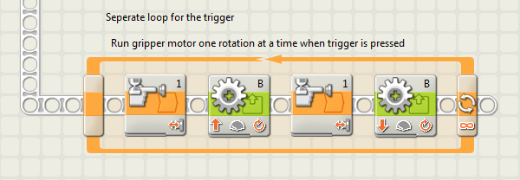
Software system
And the second part controls the grip to catch things.

Slide 15
Conclusions and future improvements
A teleoperated system is not easy at all.
It is necessary that the system has a lot of precision in control and it comes great complexity.
Future improvements:
Adding artificial vision to recognize where to find the object and calculate the relative position
Add more motors to have more degrees of freedom and the movement of the robotic arm covers a larger space
Include a motorized system to have a moving vehicle with the robotic arm.

Slide 16
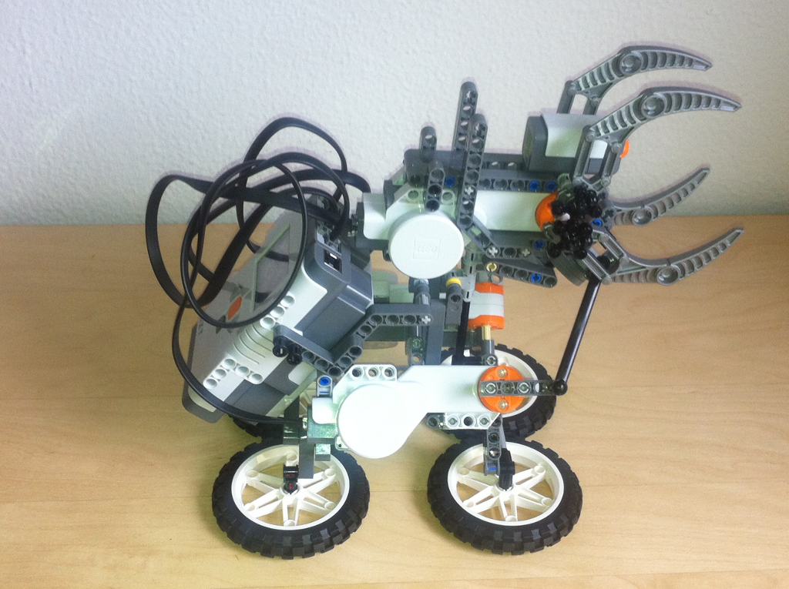
Thanks
Any question?

